Slide 1

Sentiment analysis using NLP for predicting Yelp review rating
Team Xy: Blake Belnap, Helen Ly, Jasmeer Sangha, & Karen Bennis
University of Toronto Scs Data Analytics Coding Bootcamp Final Project
August 2020

Slide 2
Topic
Sentiment analysis using natural language processing (NLP) and machine learning techniques to classify Yelp reviews by star rating
Reason for topic selection:
To expand upon the course content covering NLP
To cover a topic with universal appeal and relevance to everyday life
Notes:
Reason for topic selection
Of all the topics learned in the course, our group agreed that NLP was of particular interest
The course content covered the ETL process, and this project allowed us to see how to further incorporate NLP with machine learning models
Yelp reviews were chosen since everyone has an opinion about services and products!

Slide 3
Data sources
Sample Dataset
Raw dataset ('yelp.csv'), source: kaggle
.csv file with 10 thousand rows
Has same columns as large dataset (therefore suitable as a sample dataset)
Unequal distribution of reviews corresponding with each star rating
Dataset (big data)
Raw dataset ('yelp_review.csv'), source: kaggle
.csv file with 5.25 million rows
Selected on basis that ML model accuracy would improve with more data
Technological limitations (running Colab) prevented us from including more data, unfortunately

Slide 4
Research questions
Can NLP be used to predict sentiment of Yelp reviews?
Which machine learning model predicts Yelp sentiment with the highest accuracy?

Slide 5
Database Setup
Load the data file into a PySpark DataFrame.
Change the required data types.
Connect to the Google Cloud Storage bucket.
Transform the DataFrame into multiple DataFrames to match the schema.
Load the DataFrames to the Google Cloud SQL database.
Technologies: Google Cloud Storage (GCS), Google Cloud SQL Postgres, Google Colaboratory (Colab)
Rationale for selection: Free egress between GCS and Google Cloud SQL and Google Colab

Slide 6
Accessing data from database using Colab
1
Connect to the database using Cloud SQL Proxy.
2
Query the database for required tables.
3
Join tables into a DataFrame.
4
5
Perform data transformation adding a "class" column for the machine learning model.
Load class information to the review_class table in the database.

Slide 7
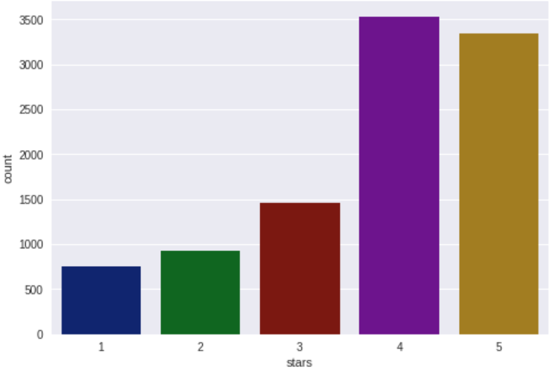
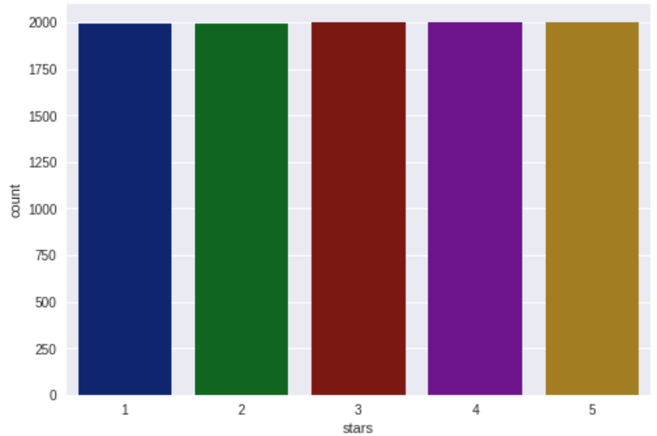
Data Exploration
Sample Dataset (‘yelp.csv’)
SAMPLE from Big Dataset (‘yelp_reviews.csv’)
Notes:
Using the sample dataset, the exploratory analysis and plotting revealed that there was an uneven distribution of reviews across the different star ratings, with most of the set being 4 and 5-star reviews. Despite the imbalance, we created various plots that looked at review text length, useful votes, cool votes, and funny votes to see if there were patterns that could be observed on the basis of star rating.
We discovered immediately that there did not appear to be much variation between a 1-star review and a 5-star review across all metrics.
In hopes of discovering more compelling patterns that might exist, we decided to draw from the larger dataset to see if this would make a difference. Based on the technical limitations of Colab, we realised that sampling more than 10 thousand rows would not be possible, so we decided to sample 10 thousand rows, ensuring equal representation from each star rating.
Unfortunately, the resampled data showed similar patterns to those observed in the sample dataset.
We concluded that star rating does not seem to influence any of the factors considered in such a profound way. At a higher level, this demonstrates the need for NLP analysis to predict sentiment.

Slide 8
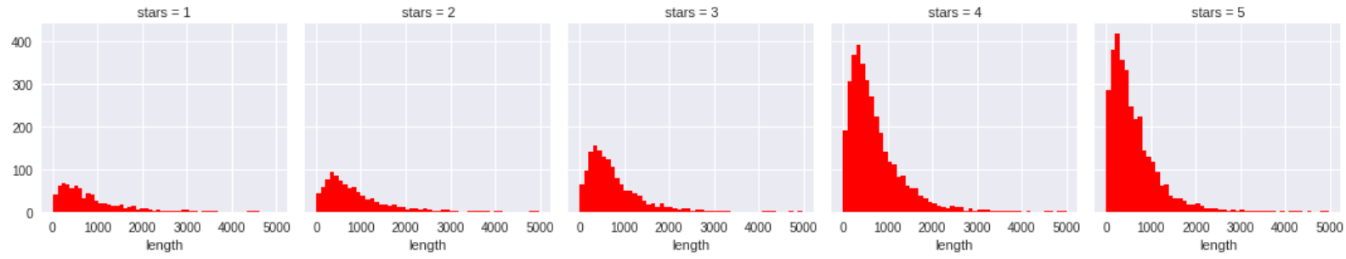
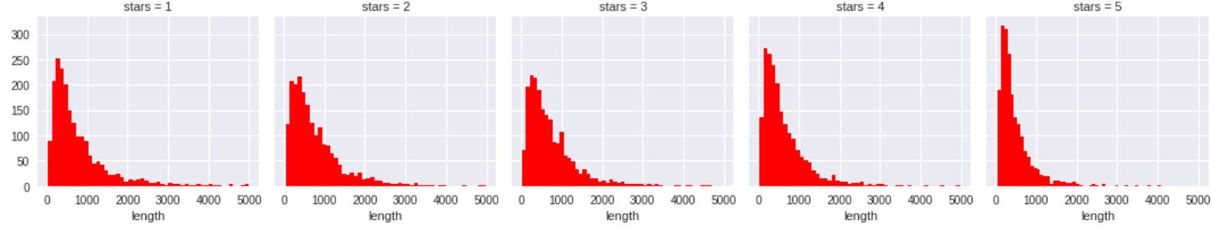
Data Exploration
Sample Dataset (‘yelp.csv’)
SAMPLE from Big Dataset (‘yelp_reviews.csv’)
Notes:
Using the sample dataset, the exploratory analysis and plotting revealed that there was an uneven distribution of reviews across the different star ratings, with most of the set being 4 and 5-star reviews. Despite the imbalance, we created various plots that looked at review text length, useful votes, cool votes, and funny votes to see if there were patterns that could be observed on the basis of star rating.
We discovered immediately that there did not appear to be much variation between a 1-star review and a 5-star review across all metrics.
In hopes of discovering more compelling patterns that might exist, we decided to draw from the larger dataset to see if this would make a difference. Based on the technical limitations of Colab, we realised that sampling more than 10 thousand rows would not be possible, so we decided to sample 10 thousand rows, ensuring equal representation from each star rating.
Unfortunately, the resampled data showed similar patterns to those observed in the sample dataset.
We concluded that star rating does not seem to influence any of the factors considered in such a profound way. At a higher level, this demonstrates the need for NLP analysis to predict sentiment.

Slide 9
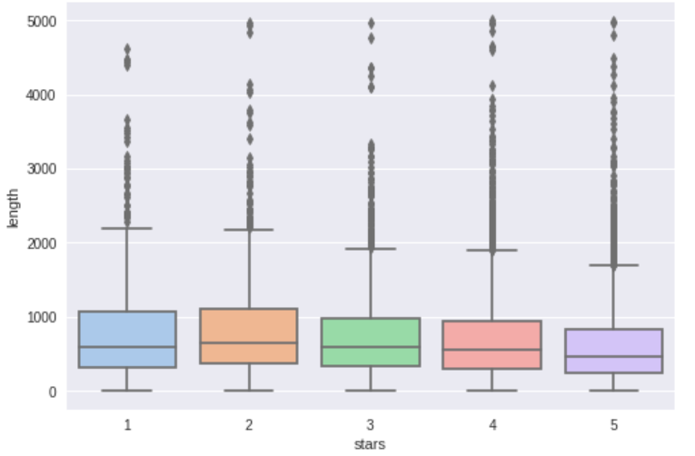
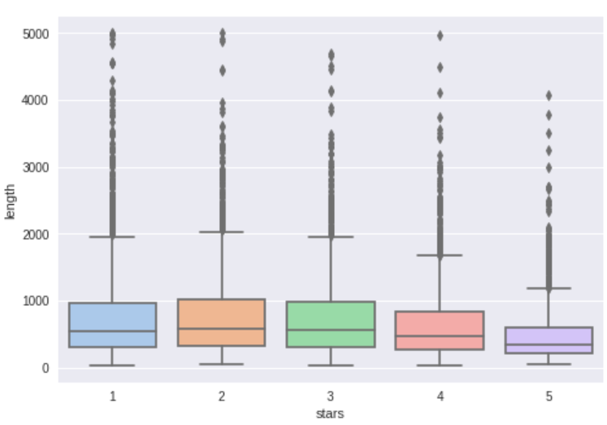
Data Exploration
Sample Dataset (‘yelp.csv’)
SAMPLE from Big Dataset (‘yelp_reviews.csv’)
Notes:
Using the sample dataset, the exploratory analysis and plotting revealed that there was an uneven distribution of reviews across the different star ratings, with most of the set being 4 and 5-star reviews. Despite the imbalance, we created various plots that looked at review text length, useful votes, cool votes, and funny votes to see if there were patterns that could be observed on the basis of star rating.
We discovered immediately that there did not appear to be much variation between a 1-star review and a 5-star review across all metrics.
In hopes of discovering more compelling patterns that might exist, we decided to draw from the larger dataset to see if this would make a difference. Based on the technical limitations of Colab, we realised that sampling more than 10 thousand rows would not be possible, so we decided to sample 10 thousand rows, ensuring equal representation from each star rating.
Unfortunately, the resampled data showed similar patterns to those observed in the sample dataset.
We concluded that star rating does not seem to influence any of the factors considered in such a profound way. At a higher level, this demonstrates the need for NLP analysis to predict sentiment.

Slide 10
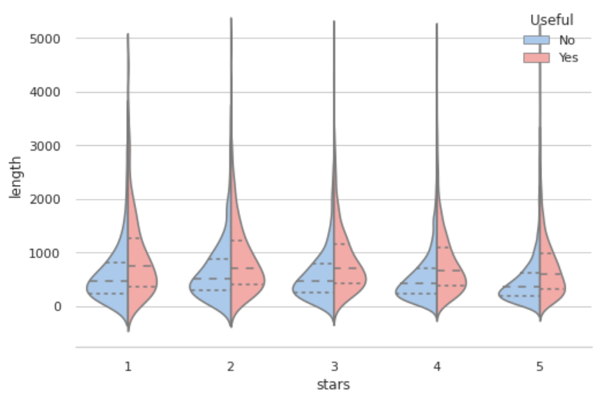
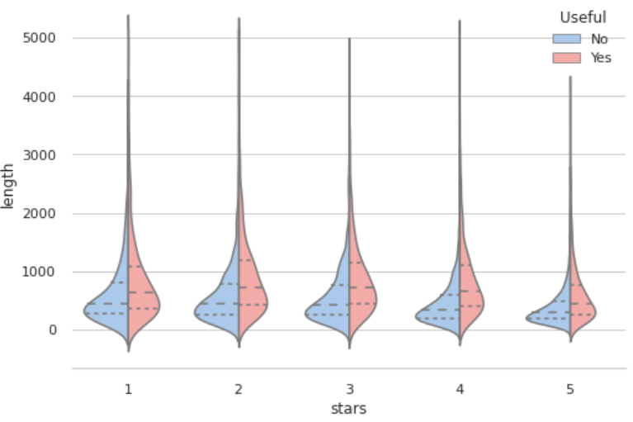
Data Exploration
Sample Dataset (‘yelp.csv’)
SAMPLE from Big Dataset (‘yelp_reviews.csv’)
Notes:
Using the sample dataset, the exploratory analysis and plotting revealed that there was an uneven distribution of reviews across the different star ratings, with most of the set being 4 and 5-star reviews. Despite the imbalance, we created various plots that looked at review text length, useful votes, cool votes, and funny votes to see if there were patterns that could be observed on the basis of star rating.
We discovered immediately that there did not appear to be much variation between a 1-star review and a 5-star review across all metrics.
In hopes of discovering more compelling patterns that might exist, we decided to draw from the larger dataset to see if this would make a difference. Based on the technical limitations of Colab, we realised that sampling more than 10 thousand rows would not be possible, so we decided to sample 10 thousand rows, ensuring equal representation from each star rating.
Unfortunately, the resampled data showed similar patterns to those observed in the sample dataset.
We concluded that star rating does not seem to influence any of the factors considered in such a profound way. At a higher level, this demonstrates the need for NLP analysis to predict sentiment.

Slide 11
Data Analysis
Machine Learning Models:
Naïve Bayes
Logistic Regression
Neural Network
Classes:
Classification | Description
Binary | Positive = ‘4 stars’, ‘5 stars’ Negative = ‘1 star’, ‘2 stars’, ‘3 stars’
3-category | Positive = ‘5 stars’ Neutral = ‘3 stars’ Negative = ‘1 star’
5-category | Best = ‘5 stars’ Good = ‘4 stars’ Neutral = ‘3 stars’ Bad = ‘2 stars’ Worst = ‘1 star’
Dataset:
10K row sample from big dataset (‘yelp_reviews.csv’)
Notes:
Originally, we'd hoped to build a model for predicting the exact number of stars based on NLP machine learning; however, we opted to include binary classification as well as multiclass categories where there are 3 classes in addition to 5 classes. The decision to include binary and 3-category classification was due to the model predictions were initially quite low in terms of accuracy when predicting the exact number of stars.

Slide 12
Data Analysis
Connect to Database
Install Java, Spark, and Findspark
Extract Tables
Read data from DB
Pull tables from DB
Transform Data
Categorize into binary categories (binary) / Drop rows with 2 and 4 stars (3-category) / Keep all rows (5-category)
Remove punctuation
Set Environment Variables
Start a SparkSession
Interact with SQL
Create Spark application
gcloud login and check the DB
download and initialize the SQL proxy
Configure settings for RDS
Join tables into PySpark DataFrame
Convert to Pandas DataFrame
Create Pipeline
Run Machine Learning Models
Tokenize data and change to lowercase
Remove stopwords
Stem and lemmatize remaining words
Add ‘length’ column
Make a copy of the DataFrame
Drop intermediate columns so ‘features’ and ‘labels’ are only ones
Change data type of ‘label’ (stars) to int
Split data into training and testing sets
(Naïve Bayes / Logistic Regression): Create model and fit training data / (Neural Net): Specify layers, create and train model
Display accuracy of model prediction of rating
Convert to a PySpark DataFrame
Create star values list (array) column
Initialize Count Vectorizer and create a vector model
One hot encode the vector model as column to the DataFrame
Create all features and feature vector
Create and run data processing pipeline
Fit and transform pipeline
Notes:
Originally, we'd hoped to build a model for predicting the exact number of stars based on NLP machine learning; however, we opted to include binary classification as well as multiclass categories where there are 3 classes in addition to 5 classes. The decision to include binary and 3-category classification was due to the model predictions were initially quite low in terms of accuracy when predicting the exact number of stars.

Slide 13
Results
Classification type | Model type | Accuracy score
Binary | Naïve Bayes | 0.802866
 | Logistic Regression | 0.877527
 | Neural Network | --
3-Category | Naïve Bayes | 0.586072
 | Logistic Regression | 0.750741
 | Neural Network | --
5-category | Naïve Bayes | 0.373853
 | Logistic Regression | 0.435023
 | Neural Network | --
Neural Network models were unable to run in Colab because it uses too much RAM, even when reducing the size of the dataset.

Slide 14
Technologies, tools, and languages
Technologies / Tools: Google Cloud Storage, Google Colaboratory, PostgreSQL, PgAdmin
Languages: Python
Libraries: Pandas, os, findspark, pyspark.sql, nltk, string, re, nltk.stem (PorterStemmer, WordNetLemmatizer), pyspark.ml.feature (HashingTF, IDF, VectorAssembler), pyspark.ml.linalg (Vector), pyspark.ml (Pipeline), pyspark.ml.classification (NaiveBayes, LogisticRegression, MultilayerPerceptronClassifier), pyspark.ml.evaluation (MulticlassClassificationEvaluator),

Slide 15
Lessons learned

Slide 16
Recommendation for future analysis

Slide 17
Questions?

